Slide 1
University-Wide
Course Evaluation Committee
Peter Biehl, Chair, Department of Anthropology
Krissy Costanzo, Committee Staff Support; Academic Affairs
March 26, 2014
Notes:
Campus Labs offers a number of products that provide data collection and reporting opportunities and because it is on one platform, these tools help bring data together to review new insight.

Slide 2
Importance of Course Evaluations
Allows students to give anonymous feedback on the quality of their course
Used by instructors to improve courses for future students, make them more relevant, and improve teaching effectiveness
Assists in the promotion and tenure process
Allows departments to improve their curriculum
Gives comparisons for benchmarking purposes

Slide 3
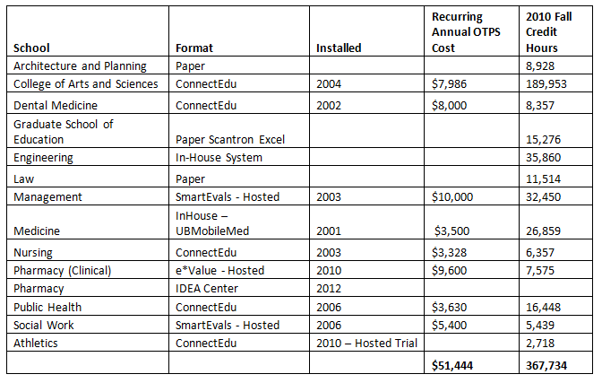
Current State – Decentralized Approach
Notes:
Currently, there are at least five different electronic and three written platforms used across our twelve schools. These diverse methods present numerous challenges by:
Causing confusion among students, especially undergraduates, who are often using multiple course evaluation platforms throughout a single semester;
Inhibiting collection of consistent institutional data for university wide assessment of instruction and learning outcomes;
Providing no common data set for evaluating instructional effectiveness at promotion;
And preventing efficiencies from both an administrative and cost perspective.

Slide 4
What are the advantages of online evaluations?
Equal Access
Better Feedback
Improved Analysis
Anonymous
Green
Notes:
If students miss a class, they still have an opportunity to assess the course
Students have equal access to evaluation tools
Improved data analysis and communication
Increased quantity and quality of results
Increased anonymity for students
Reduced environmental impact

Slide 5
Course Evaluations can be taken anywhere!
In the Quad
In Class
At Home
In the student lounge
In a Lab
Library
Notes:
Surveys can be taken from anywhere! In class, home, around campus.

Slide 6
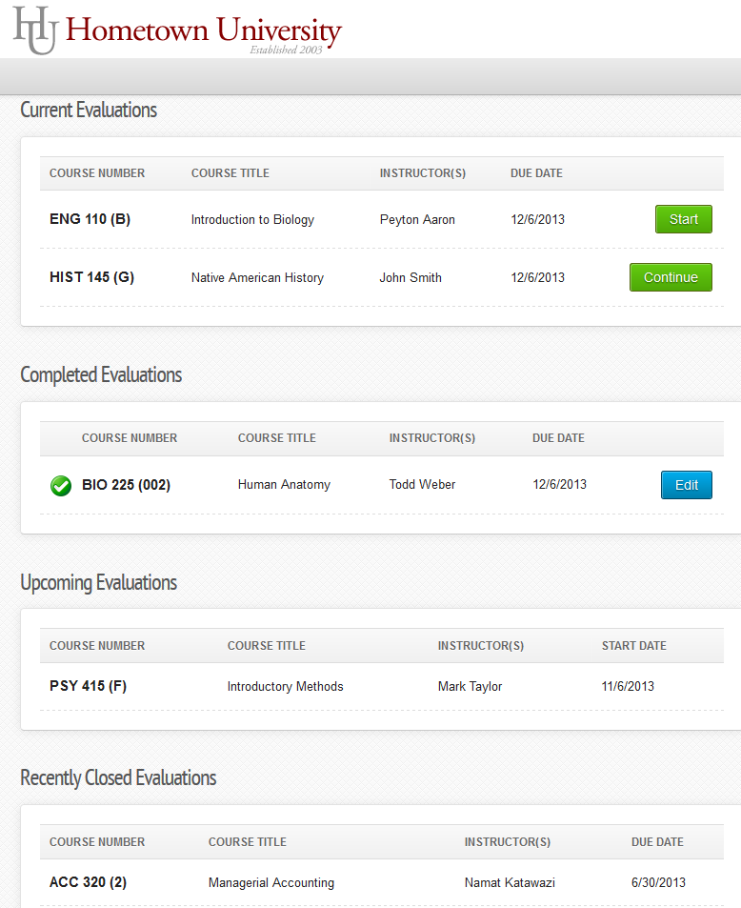
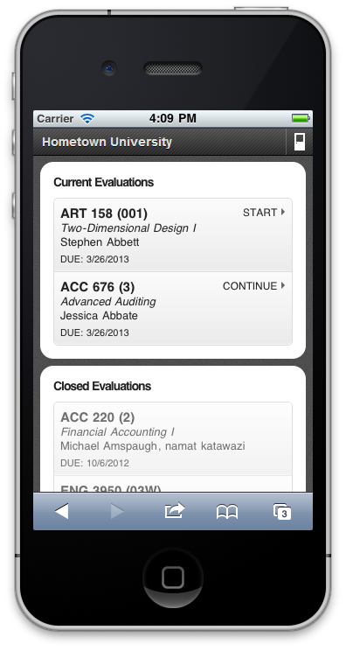
Student Surveys
University at Buffalo
Notes:
Students will be presented with a survey home page after successful log in. They will be able to view all currently active, completed, upcoming, and closed evaluations. If accessing this page on a mobile device, the page will render to the correct screen size without having to download an app or change the settings of the device.

Slide 7
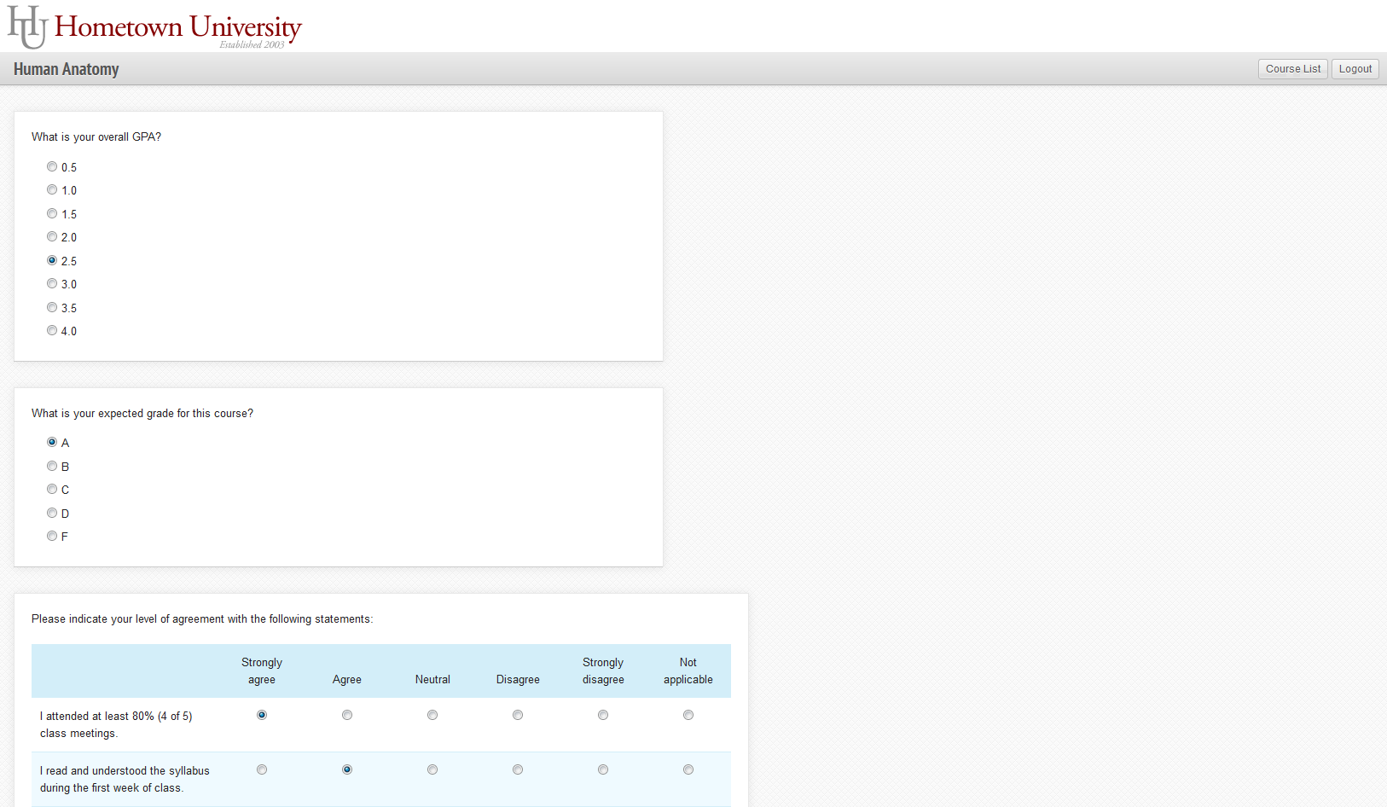
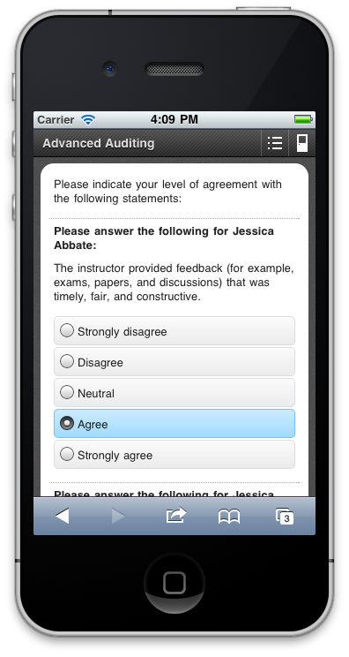
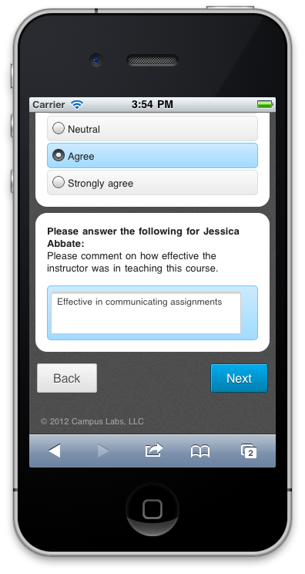
Student Survey Taking
Notes:
Survey questions will be displayed as set up by the campus administrator. Pages, or single questions will be repeated if multiple faculty are assigned to the course. The faculty member is clearly identified prior to any questions specific to their performance.
The surveys are paginated which allows for the student to automatically save their results after each page as well as leave and continue where they left off. The course evaluation system collects and reports on partial responses for surveys that are not completed based on the last page the student submitted.

Slide 8
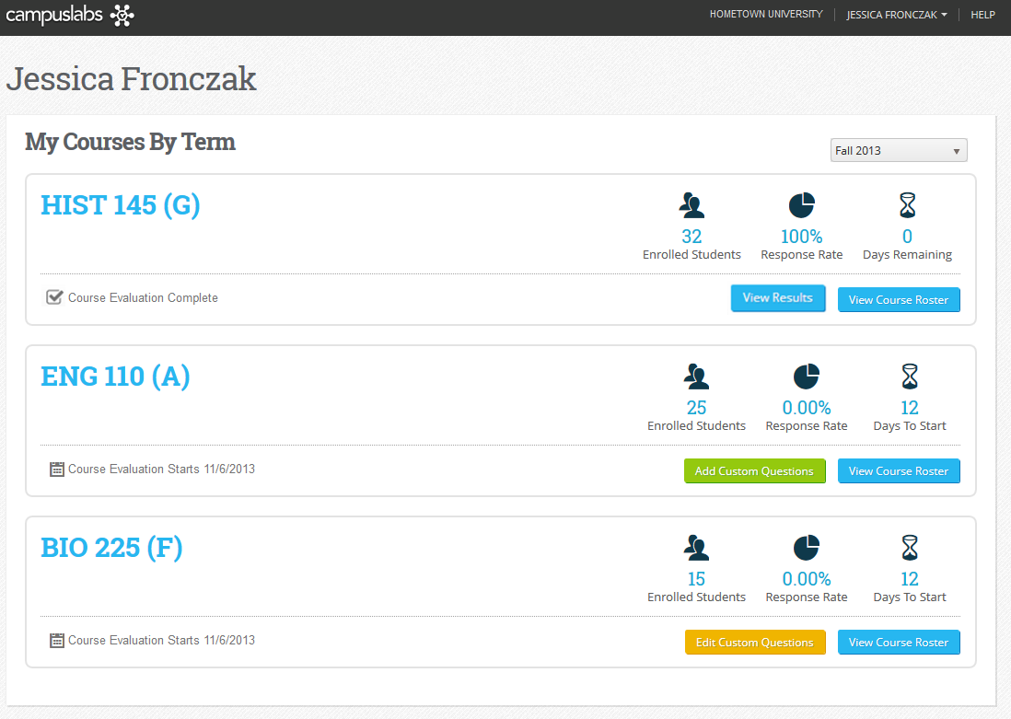
Faculty Home
University at Buffalo
Notes:
Faculty can view real time response rates on their personalized course evaluation home page. Course enrollments, dates of surveys open and close, and reporting release will also be displayed.

Slide 9
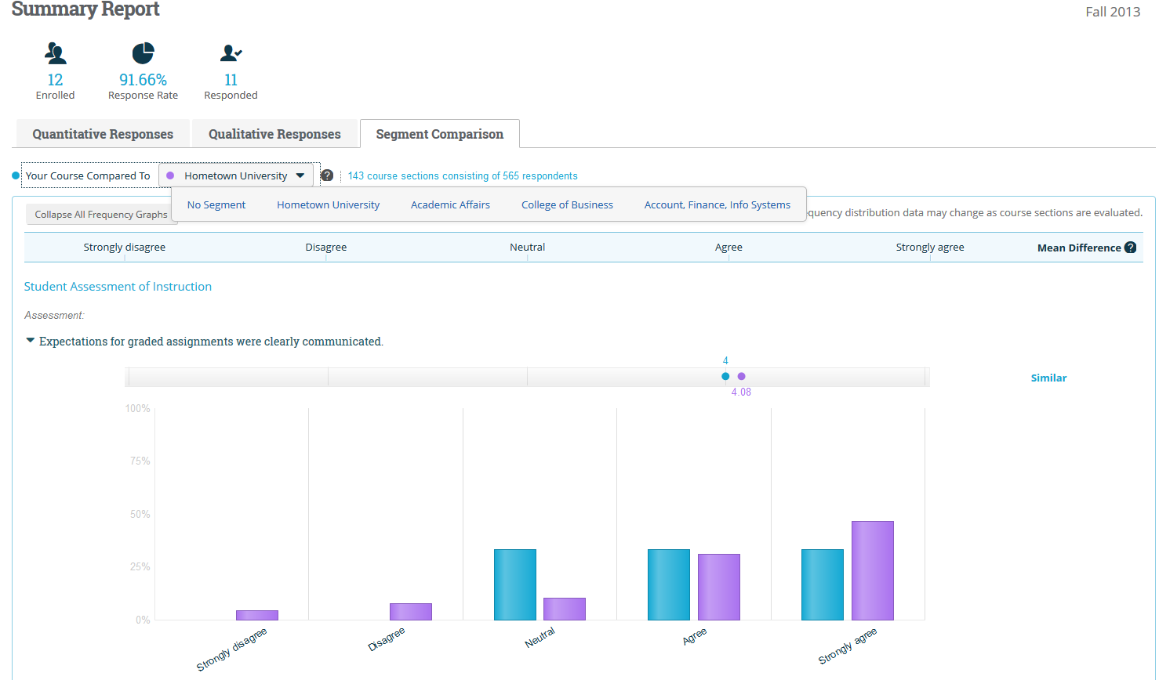
Comparison Summaries
Notes:
The segment comparison report displays a graphical representation of the mean and standard deviation versus a benchmarking segment of the Program, Department, College, or institution wide mean. The faculty can customize which segment they would like to view. Each question can be expanded to view additional frequency information.

Slide 10
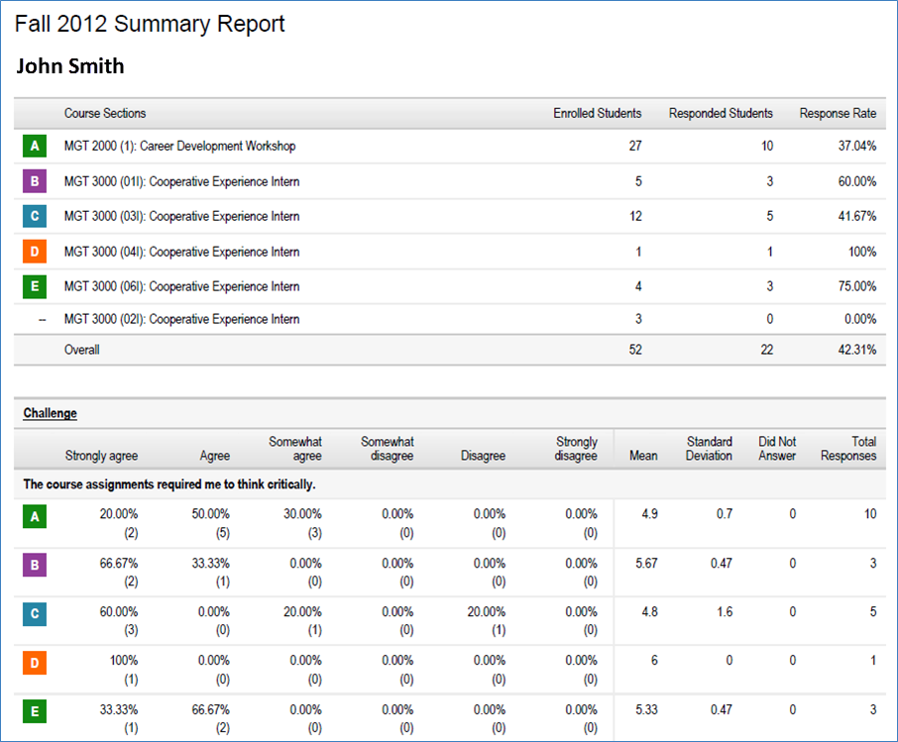
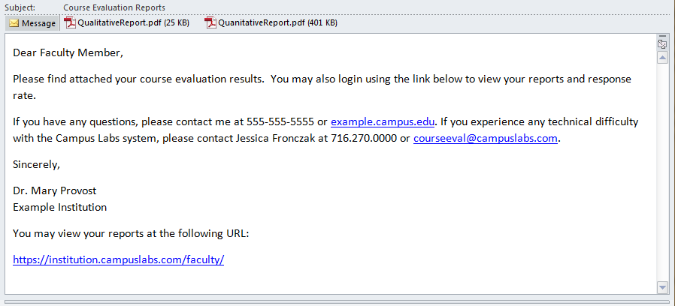
Emailed Results

Slide 11
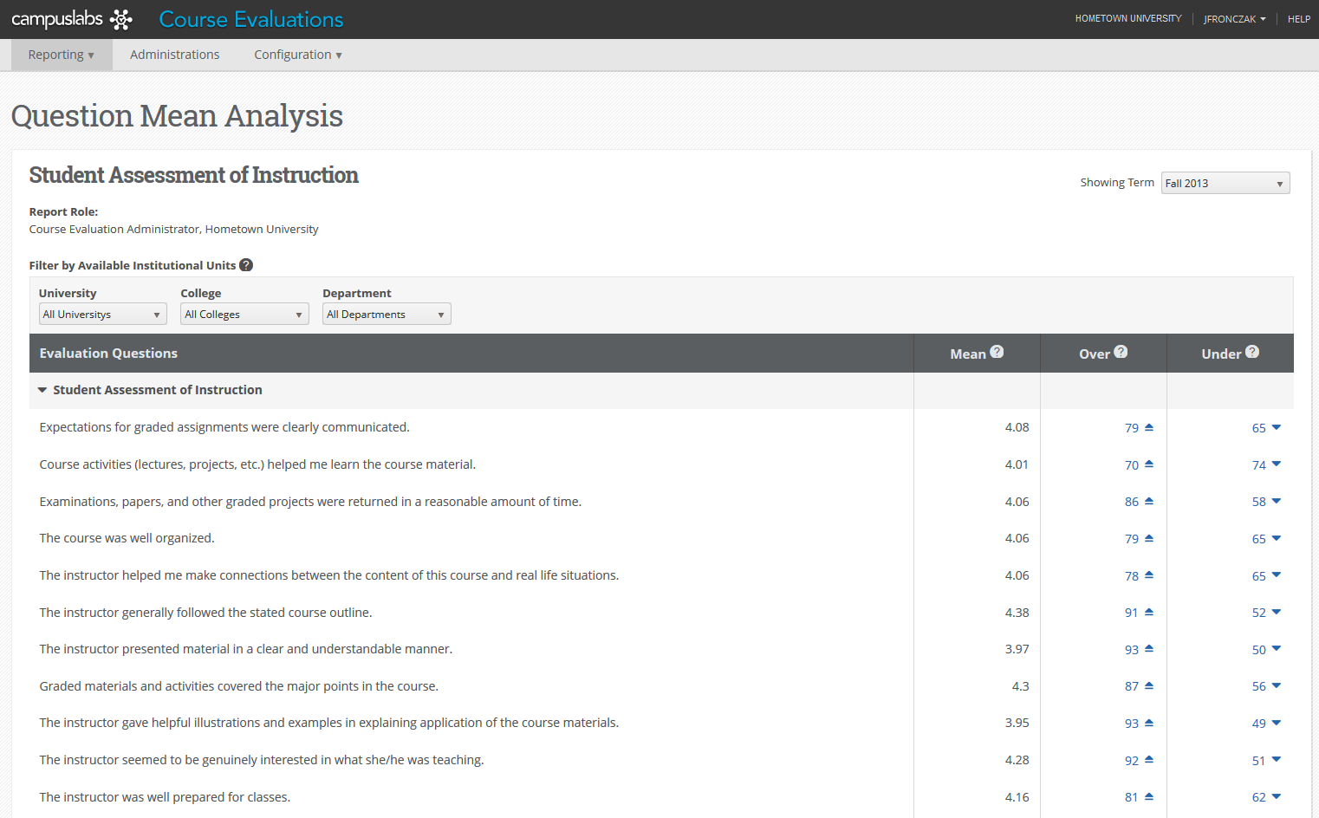
Administrator Reporting
Notes:
The Question Mean analysis is the administrator report for viewing summary data on all course sections. The main page displays each question asked on the evaluation form with the ability to drill into the data by each level of the institutional unit chart.
Over/Under is listed to show the number of courses that are over and under the mean. The numbers are hyperlinked so that when clicked on the administrator can review the list of courses in the over or under category.

Slide 12
Flexible for UB’s Needs
Accommodates…
Team Teaching
Primary Instructors, Secondary Instructors, Teaching Assistants, Course Coordinators etc.
Cross listing
Multi-tiered setup to accommodate the needs of colleges, departments, and programs for:
Reporting
Questions

Slide 13
University Core Item Set
The course was well organized. (Organization)
The course was intellectually challenging and stimulating. (Difficulty)
The work load in the course was reasonable and appropriate. (Workload)
Methods of evaluating student work were fair and appropriate. (Grading)
Overall, this was an excellent course. (Overall Course).
Please comment on the elements of the course you found particularly effective. (Qualitative)
Please comment on course improvements you would suggest. (Qualitative)

Slide 14
University Core Item Set Cont.
The instructor clearly presented what students should learn (the expected learning outcomes) for the course. (Breadth of Coverage)
The course content (assignments, readings, lectures, etc.) helped me meet the learning expectations set forth by the instructor. (Learning/Value, Assignments/Readings)
The instructor was enthusiastic about teaching the course. (Enthusiasm)
The instructor made students feel welcome in seeking help/advice in or outside of class. (Individual Rapport)
The instructor presented material clearly. (Clarity, Communication, Learning)
Overall, this was an excellent instructor. (Overall Instructor)
Please comment on how effective the instructor was in teaching this course. (Qualitative)

Slide 15
Project Timeline
Recommendation to Faculty Senate - March 26, 2014
March – Complete student focus groups and finalize item bank
April – Enter contract with vendor; begin system setup and testing with Campus Labs in preparation for Pilot in Summer 2014
May – Testing and departmental training
June – Pilot during first summer session with College of Arts & Sciences, Graduate School of Education, and School of Nursing.
July/August: Make any necessary adjustments to system from pilot, campus-wide training and promotion.
Fall 2014: University wide rollout to include Pharmacy, Dental Medicine and SMBS (with some exceptions).

Slide 16
Questions?

